Slide 1
Student Productivity & Academic Performance Analytics
A Data-Driven Analysis of Factors Influencing Student Productivity and Academic Success
Archita Singh
B.Tech Mining Engineering
IIT (ISM) Dhanbad

Slide 2
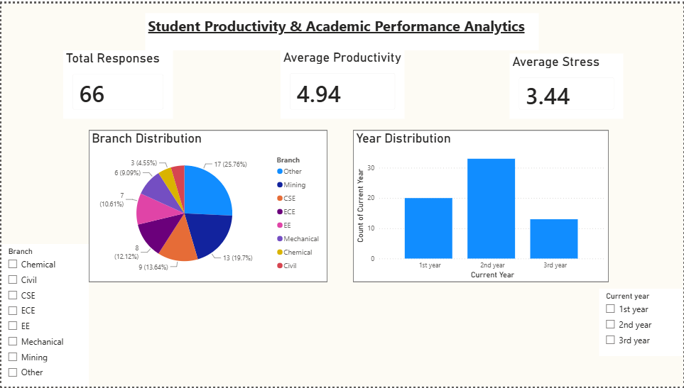
Project Overview
OBJECTIVE
DATA COLLECTION
DATA PROCESSING
VISUALISATION

Slide 3
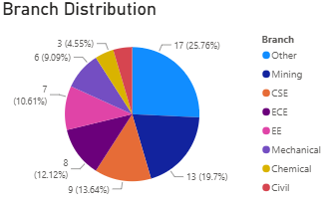
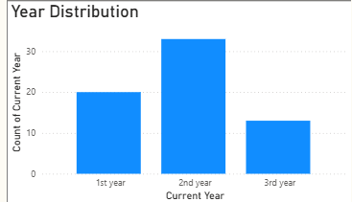
Respondent Demographics
Total Responses: 66
• Students from multiple engineering disciplines participated.
• Representation across different academic years ensured diversity in the dataset.
• The sample provides a reliable basis for analyzing productivity and academic performance patterns.
• Insights are derived from self-reported student data.

Slide 4
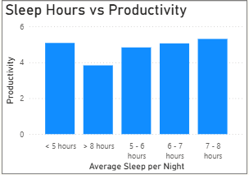
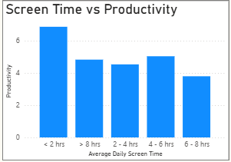
Impact of Daily Habits on Productivity
Key Findings
Students sleeping 7–8 hours generally reported higher productivity levels.
Excessive screen time showed a negative relationship with productivity.
Healthy lifestyle habits appear to contribute positively to student productivity.

Slide 5
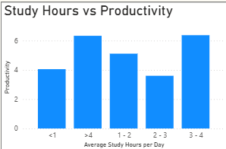
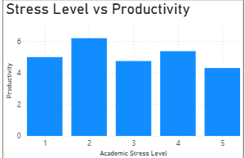
Key Productivity Drivers
Management Interpretation
Consistent study habits were associated with higher productivity scores.
Higher stress levels corresponded with reduced productivity.
Effective time management and stress management may improve student performance.

Slide 6
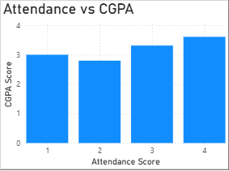
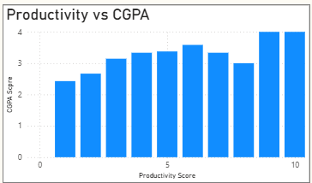
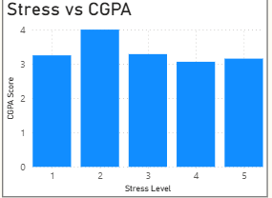
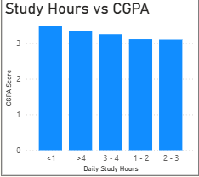
Academic Performance Analysis
Higher academic attendance was associated with stronger academic performance.
Productive students generally achieved higher CGPA scores.
Increased stress levels were linked to lower academic performance.
Consistent study habits contributed positively to CGPA.

Slide 7
Productivity and Academic Success
66
Responses
Sleep
Positive Impact
Study Hours
Positive Impact
Stress
Negative Impact
The analysis indicates that productivity and academic performance are strongly influenced by sleep quality, study habits, attendance, screen time and stress management.
Students who maintained healthier habits generally demonstrated better productivity and academic outcomes.

Slide 8
Key Insights
Higher sleep duration was associated with higher productivity levels.
Consistent study hours were associated with better outcomes.
Higher screen time was associated with lower productivity levels.
Higher attendance was associated with better CGPA.
Higher stress was associated with lower productivity and CGPA.

Slide 9
Recommendations
Academic
Excellence
Structured Study Schedule, Improve Attendance
Sleep Management , Stress Management , Digital Wellness
These recommendations focus on improving productivity and academic outcomes through healthy habits, structured study routines and better stress management.

Slide 10
Conclusion
This study identified key behavioral and academic factors associated with student productivity and academic performance.
The findings demonstrate that sleep quality, study habits, attendance, lower screen time and stress management all contribute to student success.
These insights can support data-driven strategies to improve student outcomes.

Slide 11
Thank You

